Slide 1
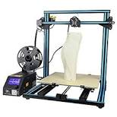
3D Printing Video of the Creality CR-10
Creality CR-10 3D Printer - $400.00 ( Print size 300mm x 300mm x 400mm) or (11.8 inches wide by 11.8 inches long by 15.7 inches tall)
ZYL PLA Filament – $17.00 for 1kg ( 2.2lbs)
Cura – Slicing software – (Free open source)
Bed temperature 60 degrees Celsius
Nozzle temperature 210 degrees Celsius

Slide 2
L.A.R.C. 3D Printing Presentation
1) What is 3D Printing
2) Thingiverse, CrabCad and My Mini Factory
3) 3D Printing and Ham Radio
4) How to get started in 3D Printing
A) Buying a printer
B) Choosing filament
C) Printer Setup
D) Printing process
5) Selling 3D printed products
6) How to print without a printer!
7) Learning resources

Slide 3
What is 3D Printing
3D printing, also known as additive manufacturing (AM), refers to processes used to create a three-dimensional object in which material is joined or solidified under computer control to create an object, with material being added together.
This is the opposite of subtractive (SM) manufacturing that occurs when using a CNC machine.
Both the 3D printer and the CNC machine do use G-Code to program the machines.

Slide 4
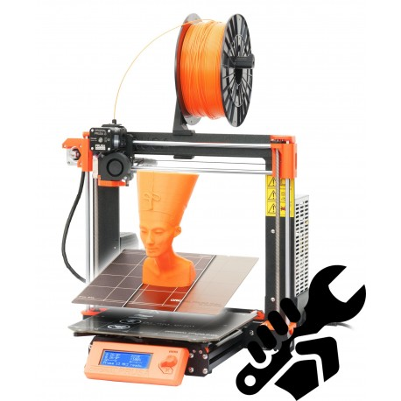
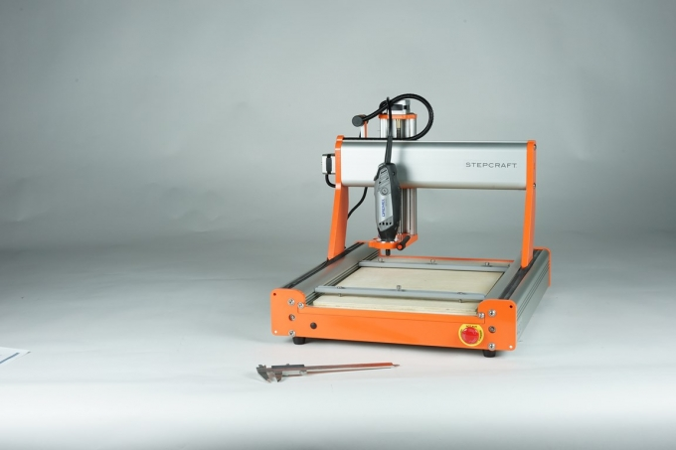
Additive/Subtractive manufacturing
Prusa Mark III
Stepcraft

Slide 5
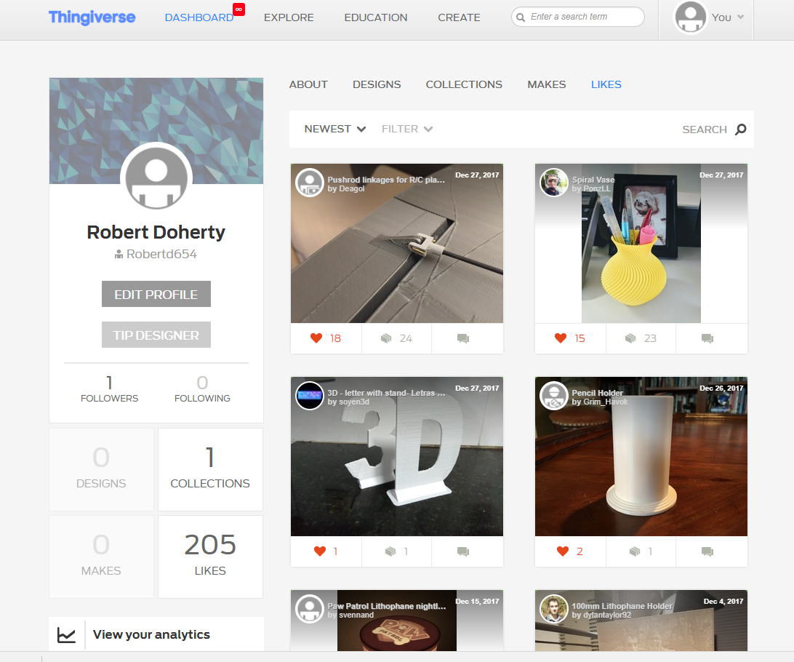
3D printing files for FREE! Thingiverse.com

Slide 6
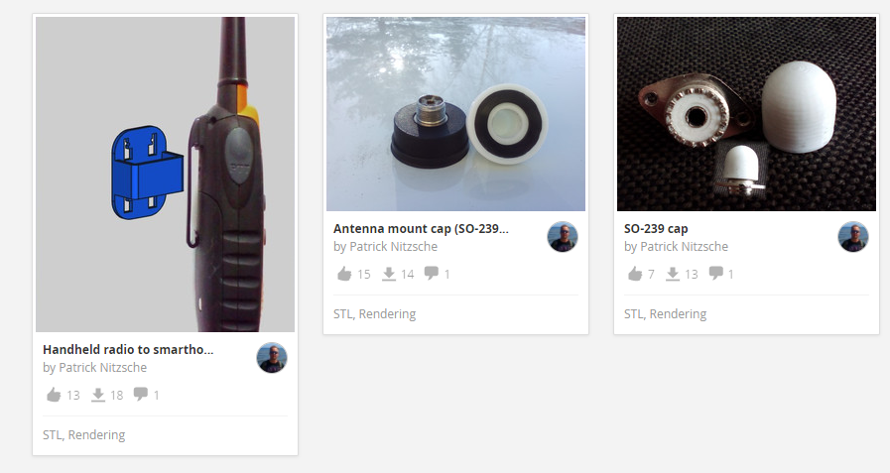
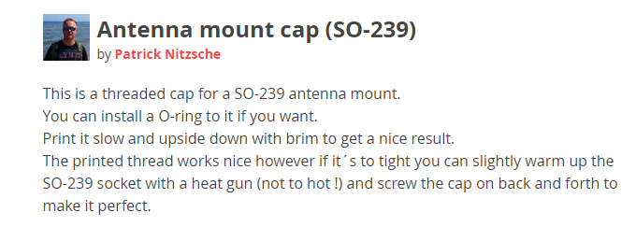
GrabCad.com

Slide 7
Myminifactory.com

Slide 8
3D Printing and Ham Radio/ Yeggi.com

Slide 9
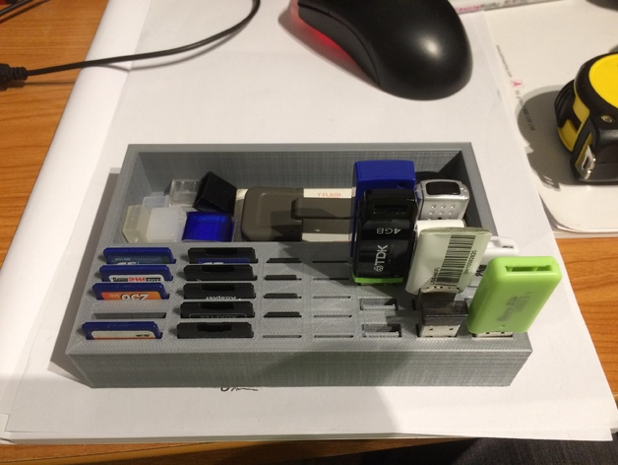
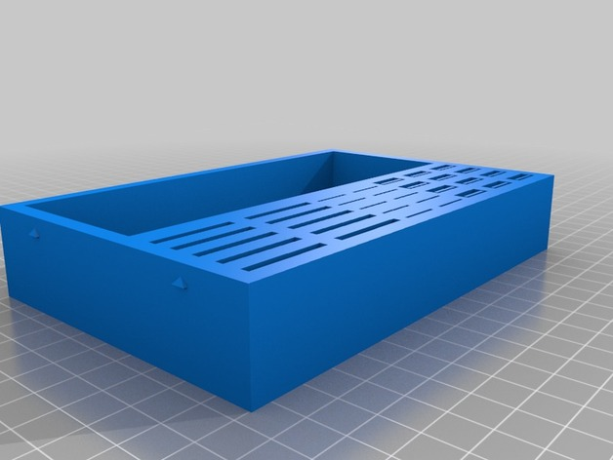
3D file process/Thingiverse.com example

Slide 10
3D Printing for Ham Radio/PCB’s
3D PRINTING: 3D PRINT A SOLDERLESS CIRCUIT BOARD
http://www.instructables.com/id/3D-Printing-3D-Print-A-Solderless-Circuit-Board/
Experimental circuit boards can be easily made with a 3D printer. They can be made at the same size and thickness as a standard 1/16" thick, through-hole soldered, perfboard.
The components can be fairly easily connected together without using solder.
This technique is somewhat faster than standard etched and soldered circuit boards. But it does require some skill and attention to detail to create a reliable circuit.
This example circuit board is a simple micro controller circuit that flashes three LED's in sequence.
It is intended to be a minimal illustration of what is possible.

Slide 11
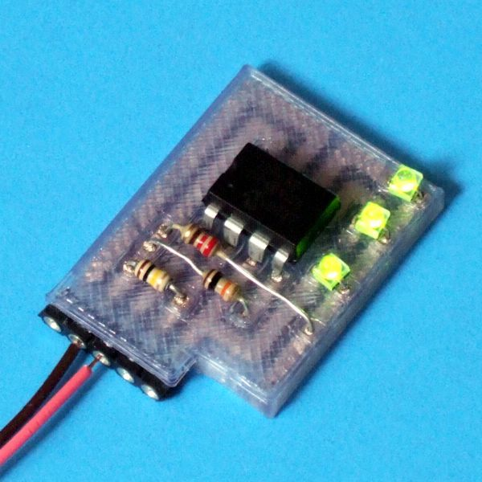
3D Printing PCB Project/Instructables
http://www.instructables.com/id/3D-Printing-3D-Print-A-Solderless-Circuit-Board

Slide 12
Ham Items….
Here are some Ham Items that are commonly printed.
Custom antenna insulators
Project enclosures
Radio mounts
Replacement knobs
Straight keys
Iambic paddles

Slide 13
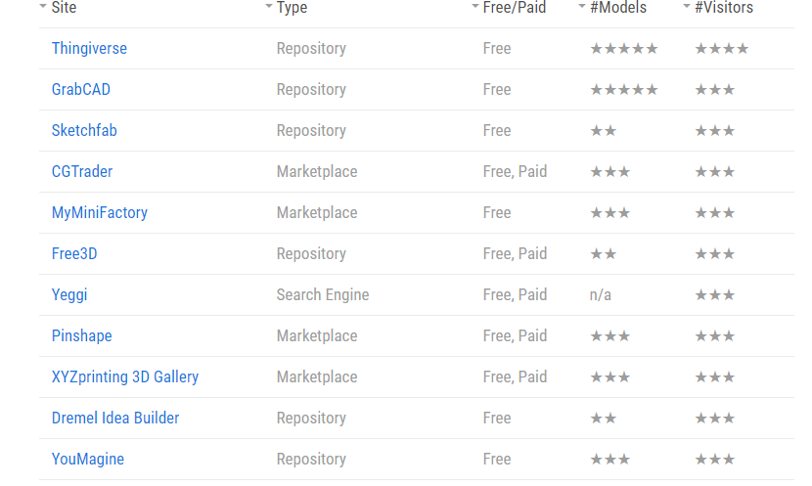
35 Best sites for .STL files

Slide 14
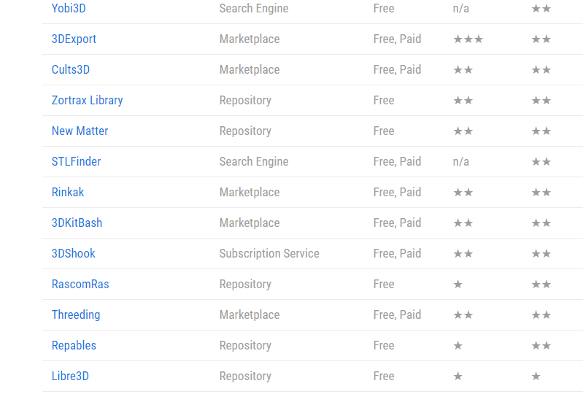
35 Best sites Continued

Slide 15
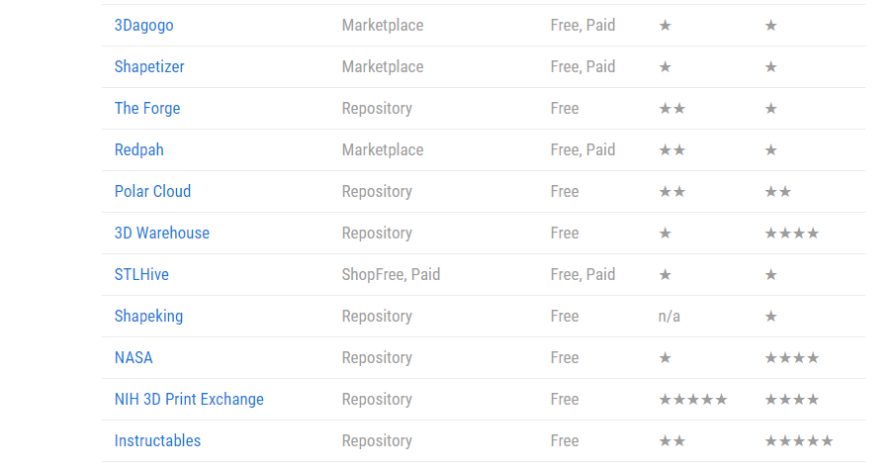
35 Best sites Continued

Slide 16
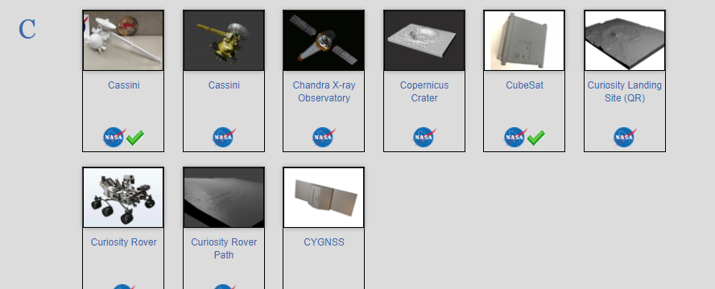
NASA ( https://nasa3d.arc.nasa.gov/models/printable

Slide 17
How to get started in 3D Printing
1.) Choosing a Printer – Kit vs Assembled – Print size
2.) Ease of use – Hobbyist vs Classroom
3.) Enclosed or open
4.) Key features – Heated bed, self leveling, Filament detection
5.) Types and where to purchase filament – PLA vs ABS vs PETG
6.) Specialty filaments – Carbon infused, Wood look, flexible filament, glow in the dark
7.) Where to buy – Prusa – Gearbest – Amazon – Banggood – E-bay
8.) Printer setup – where in your home? Noise, ventilation, security
9.) Understanding the printing process – CAD files, STL files,G-code, Slicing software, Slicing profiles.

Slide 18
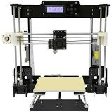
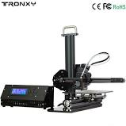
Kit vs assembled
Anet 8 /$145.99 Kit Tronxy X1 $173.00 Kit

Slide 19
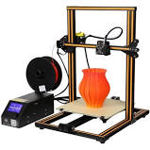
Kit vs assembled
Prusa i3 MK3 $999.99 Assembled 250mm X 210mm x 210mm
Creality CR-10 $395.67 Assembled 300mm x 300mm x 400mm

Slide 20
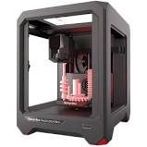
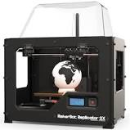
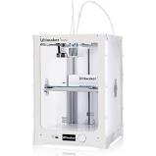
Hobbyist vs Classroom
Hobbyist printer -
Kit or mostly assembled, may or may not have a heated bed, may not have an enclosure.
Requires choosing which slicing software you will use. ( ie:Cura). Electronics may not be
fully enclosed. Allows you to choose from many brands of filament. Lower cost to purchase.
Classroom printer – Fully assembled. A plug and play experience. Electronics fully enclosed.
May require you to buy filament only from the company brand. Usually provides it’s own
Custom slicing software. Higher cost to purchase.
Makerbot mini $1299.00, Makerbot X2 $2498.99
Ultimaker 3 Extended $4,295.00

Slide 21
How to get started in 3D Printing
1.) Choosing a Printer – Kit vs Assembled – Print size
2.) Ease of use – Hobbyist vs Classroom
3.) Enclosed or open
4.) Key features – Heated bed, self leveling, Filament detection
5.) Types and where to purchase filament – PLA vs ABS vs PETG
6.) Specialty filaments – Carbon infused, Wood look, flexible filament, glow in the dark
7.) Where to buy – Prusa – Gearbest – Amazon – Banggood – E-bay
8.) Printer setup – where in your home? Noise, ventilation, security
9.) Understanding the printing process – CAD files, STL files,G-code, Slicing software, Slicing profiles.

Slide 22
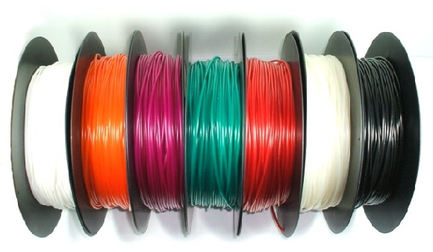
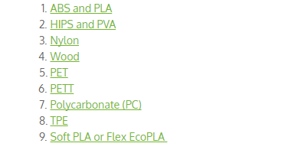
Filament

Slide 23
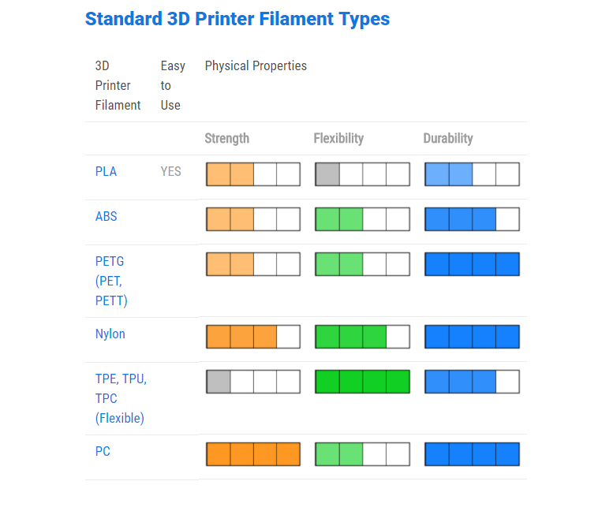
Standard 3D Printer Filament Types

Slide 24
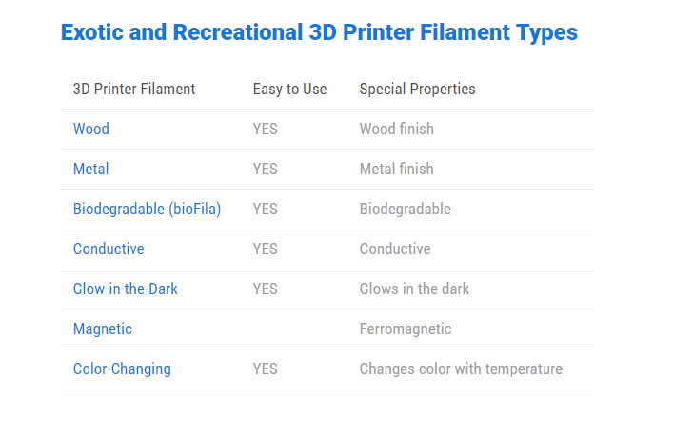
Exotic and Recreational Filament

Slide 25
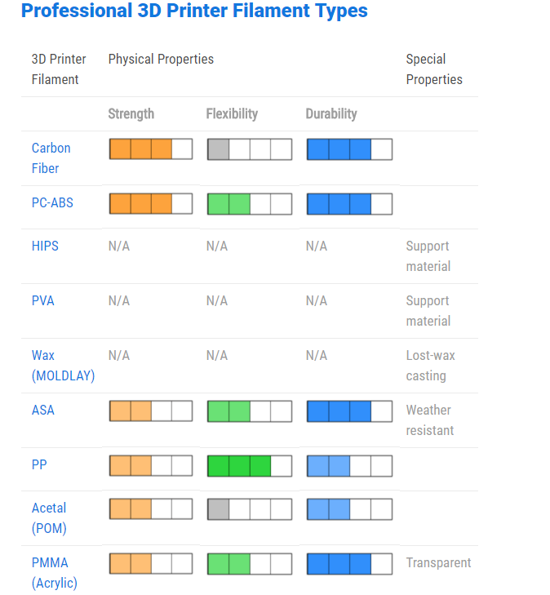
Professional Filament

Slide 26
Where to purchase filament
Finding your favorite filament can take some time and experimenting.
Different products can require different types. Join facebook groups, forums, and do
internet searches to get the information you need.
Filament sources.
E-bay ( ZYLTech – 1.75mm* PLA for around $17.00/kg)
Amazon
Gearbest
MatterHackers
These are just to name a few. Many companies that produce filament will also sell direct.
*Filament can come in 1.75mm or 3.0mm – 1.75mm is most common so be sure!

Slide 27
How to get started in 3D Printing
1.) Choosing a Printer – Kit vs Assembled – Print size
2.) Ease of use – Hobbyist vs Classroom
3.) Enclosed or open
4.) Key features – Heated bed, self leveling, Filament detection
5.) Types and where to purchase filament – PLA vs ABS vs PETG
6.) Specialty filaments – Carbon infused, Wood look, flexible filament, glow in the dark
7.) Where to buy – Prusa – Gearbest – Amazon – Banggood – E-bay
8.) Printer setup – where in your home? Noise, ventilation, security
9.) Understanding the printing process – CAD files, STL files,G-code, Slicing software, Slicing profiles.

Slide 28
Home printer setup/Considerations
Here is a list of things to consider when looking for a place in your home to setup
your 3D Printer.
1.) Ventilation
2.) Pet and child security
3.) Air conditioning drafts
4.) Solid and level surface
5.) Isolation of noise

Slide 29
The Printing Process
CAD design you create.
CAD design is saved as an .STL file
.STL file is downloaded to your computer
.STL file is imported into the slicing software
Sliced file is then saved as a .gcode file
.gcode file is then uploaded to your 3D printer for printing.
CAS design you download from a free or paid site.
CAD .STL file is downloaded from the free or paid site to your computer.
.STL file is imported into your slicing software
Sliced file is then saved as a .gcode file
.gcode file is then uploaded to your 3D printer for printing.
NOTE: Depending on the 3D printer uploading a .gcode file will involve one of
the following – 1.) using an SD card, using wireless, or having your printer
connected to your computer by USB cable.

Slide 30
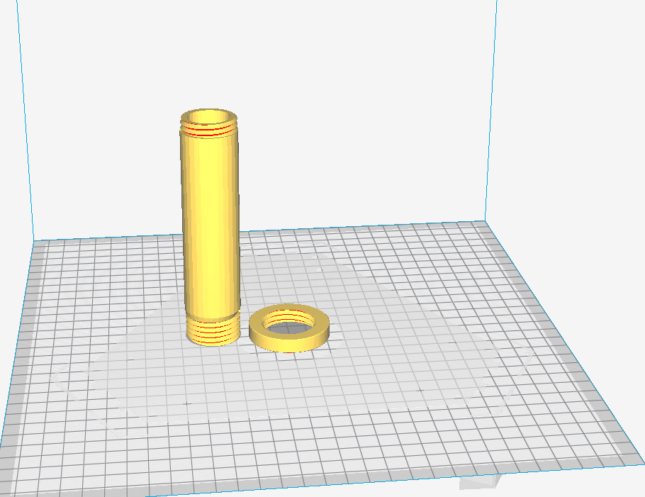
View of a sliced file – Cura software

Slide 31
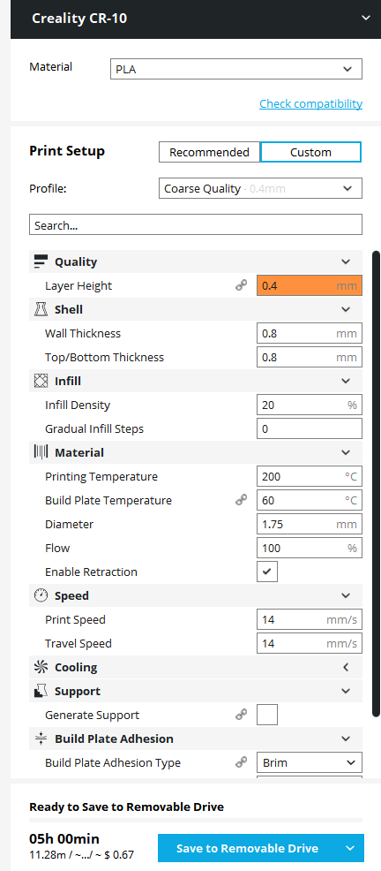
Cura profile

Slide 32
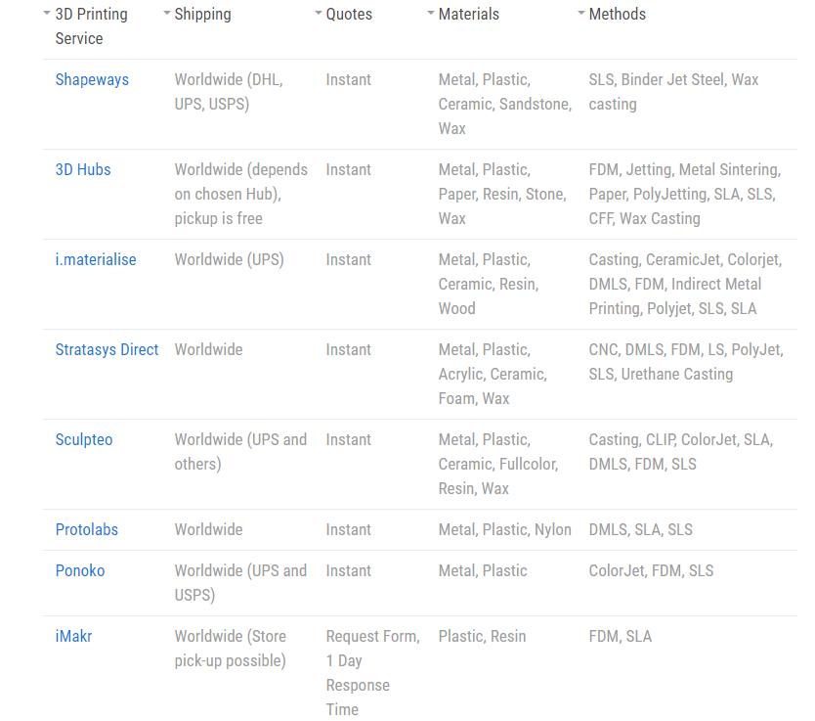
How to 3D print without a printer!

Slide 33
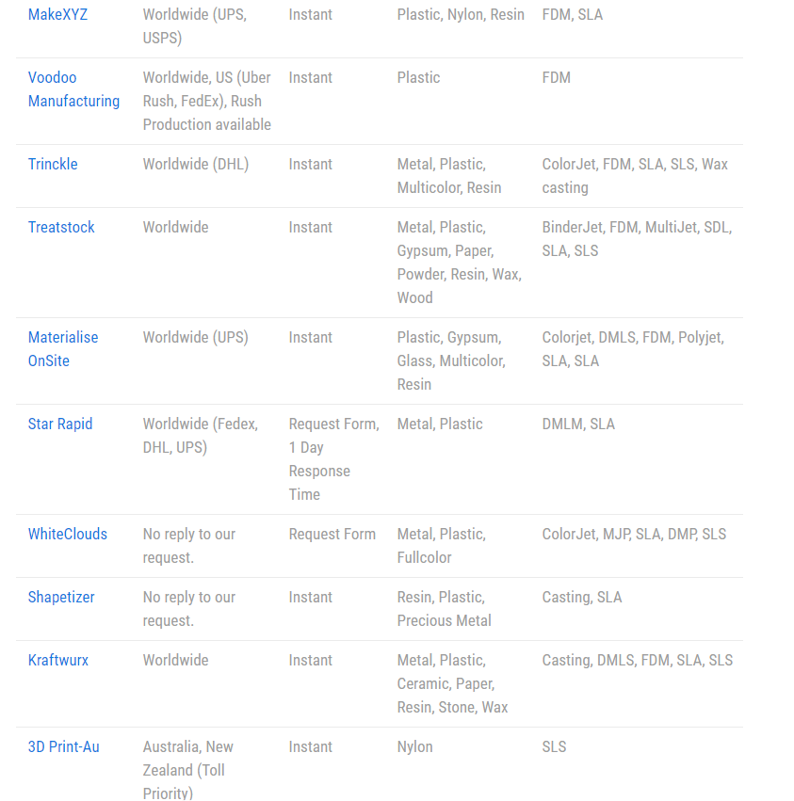
Printing services continued

Slide 34
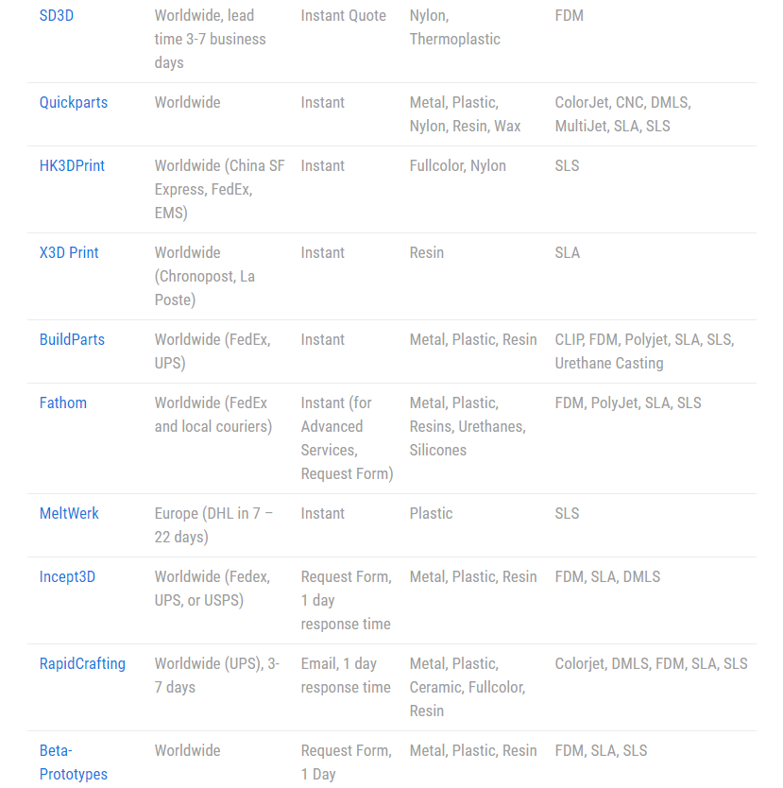
Printing services continued (2)

Slide 35
Learning Resources
1.) YouTube Channels – 3D printing
Makers Muse ( Angus Deveson)
3D Printing Nerd ( Joel Telling)
3D Printing Professor
YouTube Channels – CAD design with Fusion 36
Lars Christensen
YouTube Channel for – Spark mechanical design
Hoffman Engineering
2.) Udemy – 3D printing – CAD Design
Udemy.com
3.) Autodesk ( Fusion 360) https://www.autodesk.com/products/
fusion-360/students-teachers-educators
4.) Spark Mechanical Design
https://www.rs-online.com/designspark/mechanical-download-and-installation
5.) For a simpler CAD program check out Tinkercad.com

Slide 36
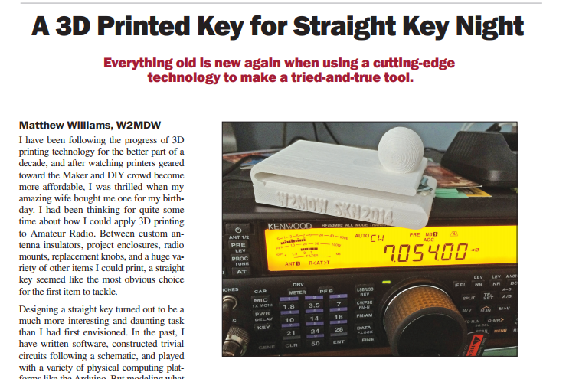
QST – January 2016
See additional PDF file /
“ A 3D Printed Key for Straight Key Night”

Slide 37
Thank you!
If you have any further questions about 3D Printing you may
contact me at KM4BAO@yahoo.com
Thank you for attending tonight’s meeting.

