Slide 1
Mar 7, 2016

Slide 2
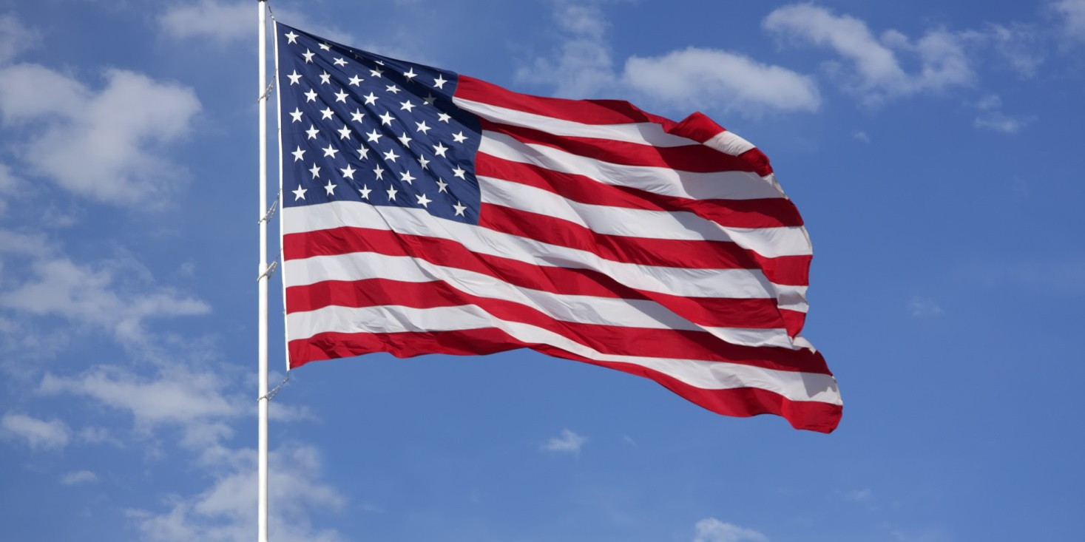

Slide 3
We had 4 persons pass their license exams tonight.
Sarah Clark K4EMT - Extra
Keith Otstot W4HKO - Extra
Victor Marker KI4UNH - General
James Wetherington - Technician

Slide 4
LARC Name Tag
If you are owed a LARC name tag but have not received it please contact:
Bill Johnson, KI4ZMV
LARC Secretary

Slide 5
Guests?
Do we have any first time visitors, guests, or people who just want to stand up and be recognized?

Slide 6
ARRL NPOTA
The ARRL National Parks on the Air is the ARRL promotional to celebrate the 100th anniversary of the National Parks Service. The National Parks Service was founded in 1916 and is a bureau of the US Department of Interior.
LARC members operating with the club call sign of K4LKL have already been taking part. It can be a daunting task. Information to be provided by Matthew, KK4FEM, LARC VP.

Slide 7
Field Day !!!
Field Day is always the fourth full weekend of June, beginning at 1800 UTC Saturday and running through 2059 UTC Sunday. Field Day 2016 is June 25-26.

Slide 8
Remember to visit the
ARRL West Central Florida Section
website at:
http://arrlwcf.org/
for all of the up to date information about your section, WCF, West Central Florida

Slide 9
Happy Birthday LARC
40th Anniversary
March 17, 1976 to present
We started as the Lakeland Repeater Association.

Slide 10
K4LKL On The Air
Would you like to be K4LKL on the air as part of our 40th anniversary this year? You can be! As this is our 40th anniversary this year we will be promoting the club by allowing club members to put us on the air. We will be QSLing with a QSL that reflects our club information and anniversary. Rules: You must sign up to use the call. You must use the call within the bounds of your license restrictions. Techs in the Tech band, Generals in general band and so on. You must keep an accurate log and submit it to Matthew KK4FEM, our vice president. It will end up on LOTW. Contact me or Matthew for more information.

Slide 14
LARC Picnic
Lake Parker Park
2 April 2016
The club will supply burgers, dogs and buns. Bring a dish to share and something to drink.

Slide 15
March for Babies - Polk County 2016
Date: Saturday, April 30, 2016
Time for the public: 9:00AM
Registration for public: 8:00AM
First Presbyterian Church
175 Lake Hollingsworth Dr
Lakeland, FL 33801
Volunteers are needed. We arrive around 7AM. This is lots of fun for a great cause.

Slide 16
Kathleen Area Historical Society
Commemorates 25 Years!
If you have an affection for and attachment to the historic communities, traditions, and people of: Galloway, Gibsonia, Green Pond, Griffin, Kathleen, Providence, Socrum, or Winston (Est. 1850-1900), join us on SATURDAY, MARCH 19 as we celebrate our 25th Anniversary at our annual Heritage Day event!
Location: Heritage Park 8950 N Campbell Rd , Lakeland, FL 33810
Live Entertainment, vendors, Silent Auction, children's activities, pioneer life exhibit and skills demonstrations like cane grinding/syrup making and whip cracking, drawings, southern style vittles, local dignitaries and MORE! The fun begins at 8 a.m

Slide 17
Guest speakers tonight are:
Tom Ruhlman – W9IPR
Batteries
Matthew Stevens – KK4FEM
NPOTA activations in Utah

