Slide 1
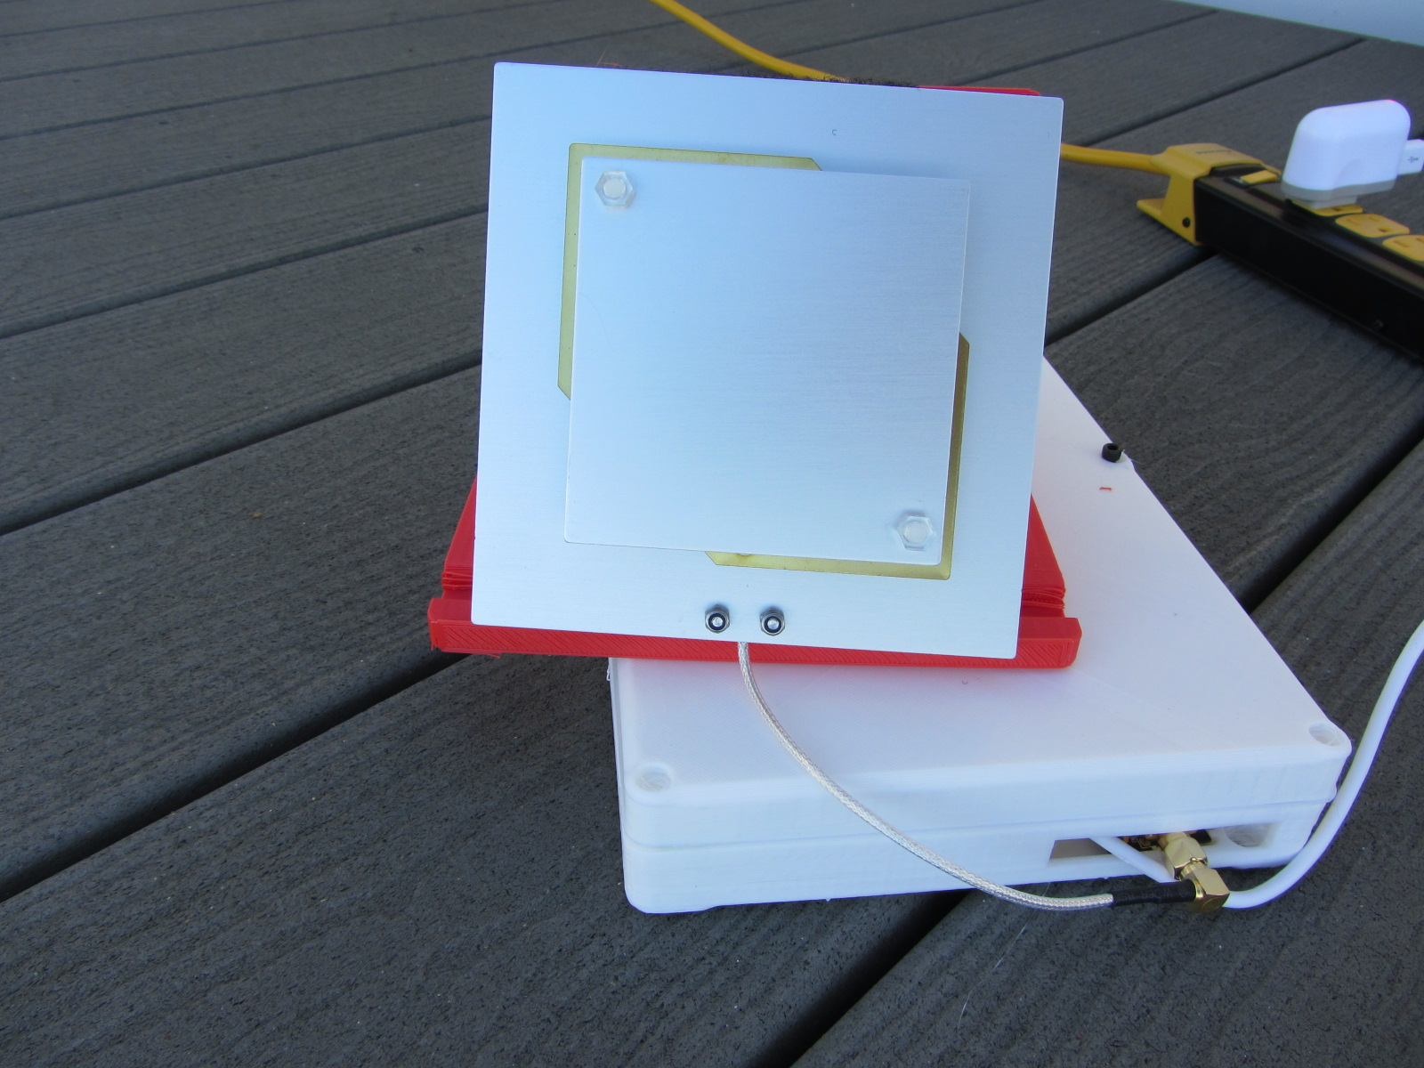
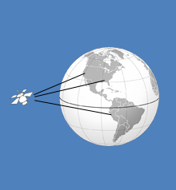
Outernet Project – LARC November 6th, 2017 – Bob Doherty - KM4BAO

Slide 2
The Outernet Project
What is the Outernet
History of the Outernet
Future of the Outernet
Can the Outernet serve Ham Radio
Building an Outernet Receiver

Slide 3
What is the Outernet?
Outernet, Inc is a software-defined radio and broadcast data company. Outernet, Inc sells the components needed to build and receive Outernet satellite broadcasts.
Outernet's goal is to provide free access to content from the web through geostationary and Low Earth Orbit satellites, made available effectively to all parts of the world. The project currently uses datacasting conventional geostationary communications satellites in a satellite constellation network. Wi-Fi enabled devices communicate with the satellite hotspots, which receive data broadcasts from satellites.( Your Browser is used to look at received files and status of Satellite reception)

Slide 4
History of the Outernet
Outernet turned on their first public satellite signal on August 11, 2014. Today Outernet transmits 20 MB per day. Outernet provides instructions for users to build their own receivers and encourages people to do so, then to share their results with Outernet. Outernet's first signal was broadcast over Galaxy 19 and Hot Bird, covering North America, Europe, and parts of the Middle East and North Africa. The company no longer operates a Ku-band service. It now delivers content globally through Inmarsat's I4 constellation. The network is primarily focused on a one-way data service, with two-way traffic being a long-term goal of the company.

Slide 5
Satellite Locations
Alphasat and Inmarsat-4 satellites
Following the full deployment of the Inmarsat-4 (I-4) satellite constellation in 2009, a further three satellite regions were created over the Earth’s major landmasses.
I-4 F1 Asia-Pacific, at 143.5 degrees East
I-4 F2 EMEA (Europe, Middle East and Africa), at 63.9 degrees East
I-4 F3 Americas, at 98.4 degrees West
Alphasat was launched in 2013 to supplement the I-4 network, at 24.9 degrees East.

Slide 6
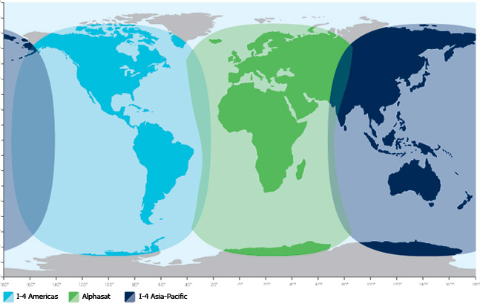
Geostationary Orbit

Slide 7
Geostationary Orbit
A geostationary orbit, geostationary Earth orbit or geosynchronous equatorial orbit[1] (GEO) is a circular orbit 35,786 kilometres (22,236 mi) above the Earth's equator and following the direction of the Earth's rotation. An object in such an orbit has an orbital period equal to the Earth's rotational period (one sidereal day) and thus appears motionless, at a fixed position in the sky, to ground observers. Communications satellites and weather satellites are often placed in geostationary orbits, so that the satellite antennas (located on Earth) that communicate with them do not have to rotate to track them, but can be pointed permanently at the position in the sky where the satellites are located

Slide 8
Future of the Outernet
Cost of Data – 20mb per day – needs to be increased
Potential Competetion – Google- Project Loon
and Facebook.
Next 3-6 months are important to the Outernet service as new satellite data rates are negotiated and a new receiver board to replace Dreamcatcher is anticipated.
Like the Outernet the goal of Google and Facebook is to capture a share of the close to 5 billion people on earth without internet service.

Slide 9
Project Loon by Google
Now Google is going to dominate space: Search giant to launch 180 satellites to provide internet access for the ENTIRE planet, sources claim
Sources claim Google will spend more than $1bn (£600m) on technology
Satellites will orbit the Earth at lower altitudes than traditional satellites
Group also acquired a drone company to provide internet connectivity
Facebook, meanwhile, is developing its own solar-powered drones, satellites and lasers to deliver web access to underdeveloped countries
A separate Google project, dubbed Project Loon, is designing high-altitude balloons to provide broadband service to remote regions of the world
Read more: http://www.dailymail.co.uk/sciencetech/article-2646039/Googles-plans-world-domination-Search-giant-launch-180-satellites-bring-internet-access-ENTIRE-planet.html#ixzz4wp6HPLsK
Follow us: @MailOnline on Twitter | DailyMail on Facebook

Slide 10
Can Outernet serve ham radio?
Ability to receive AMSAT data, news and information in
Remote areas - US remote areas with no cell phone, wifi, or internet cable service.
Remote islands used for DX-pedition
As a stem project to attract students to Ham Radio and digital communications.
Disaster areas – Hurricanes/ Earthquakes/ Wildfires

Slide 11
Outernet Content – Amateur Radio
Amateur Radio

Slide 12
Outernet Content
APRS

Slide 13
Outernet Content - Amateur Radio
APRSAT

Slide 14
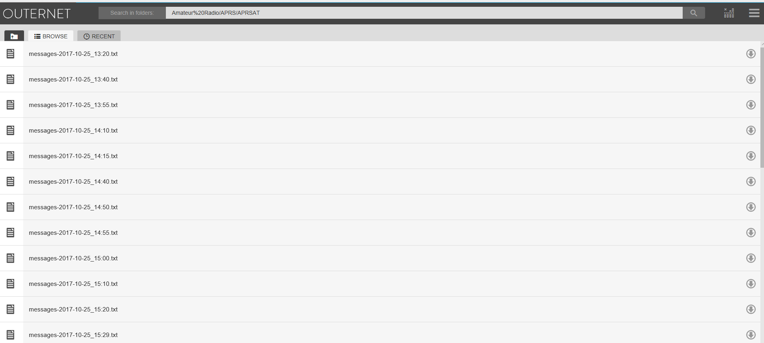
Outernet Content - Amateur Radio
Messages

Slide 15
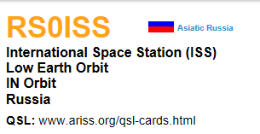
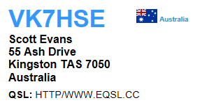
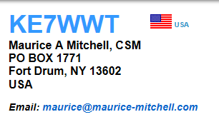
Outernet Content - Amateur Radio
RS0ISS>CQ,qAR,VK7HSE-2:>ARISS - International Space Station
KE7WWT-1>APMI01,TCPIP*,qAS,KE7WWT:OUTNET

Slide 16
Outernet - News

Slide 17
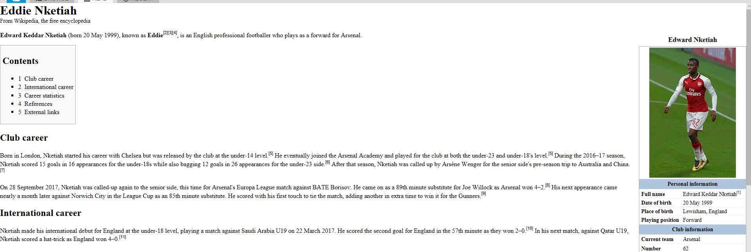
Outernet - Wikipedia

Slide 18
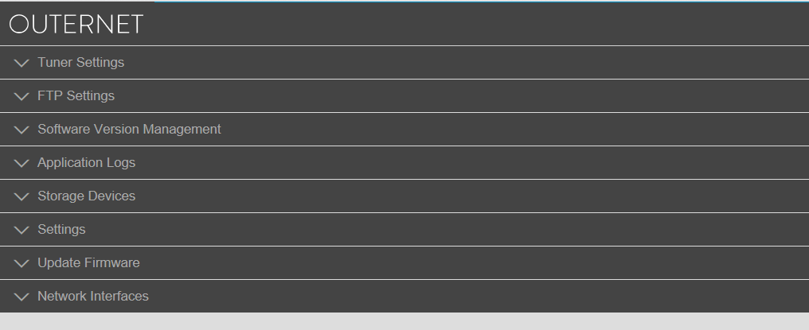
Outernet – Tuner Settings

Slide 19
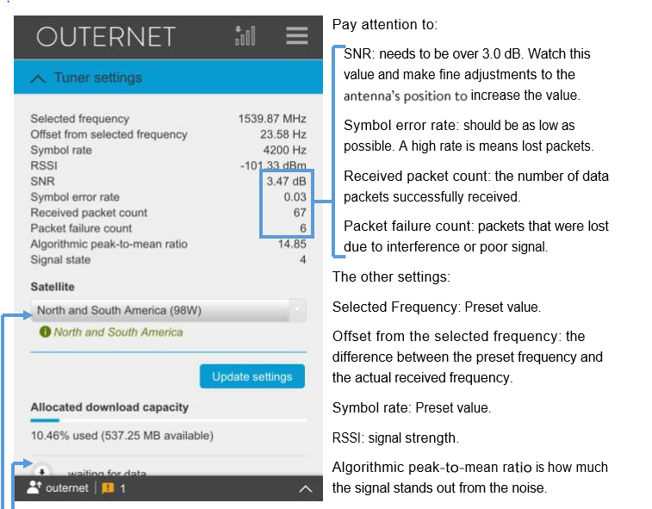
Outernet – Tuner Settings

Slide 20
Outernet – How to build an Outernet receiver
The Old way – Raspberry Pi 3 – Use L-Band Receiver PDF – Email Bob Doherty ( KM4BAO@yahoo.com ) for raspberry pi instructions and Raspian software to run Outernet.
The New way – Dreamcatcher – Go to Outernet.is in your web browser. Click Forums/ Click Documentation /Click DIY User Kit Manual.html

Slide 21
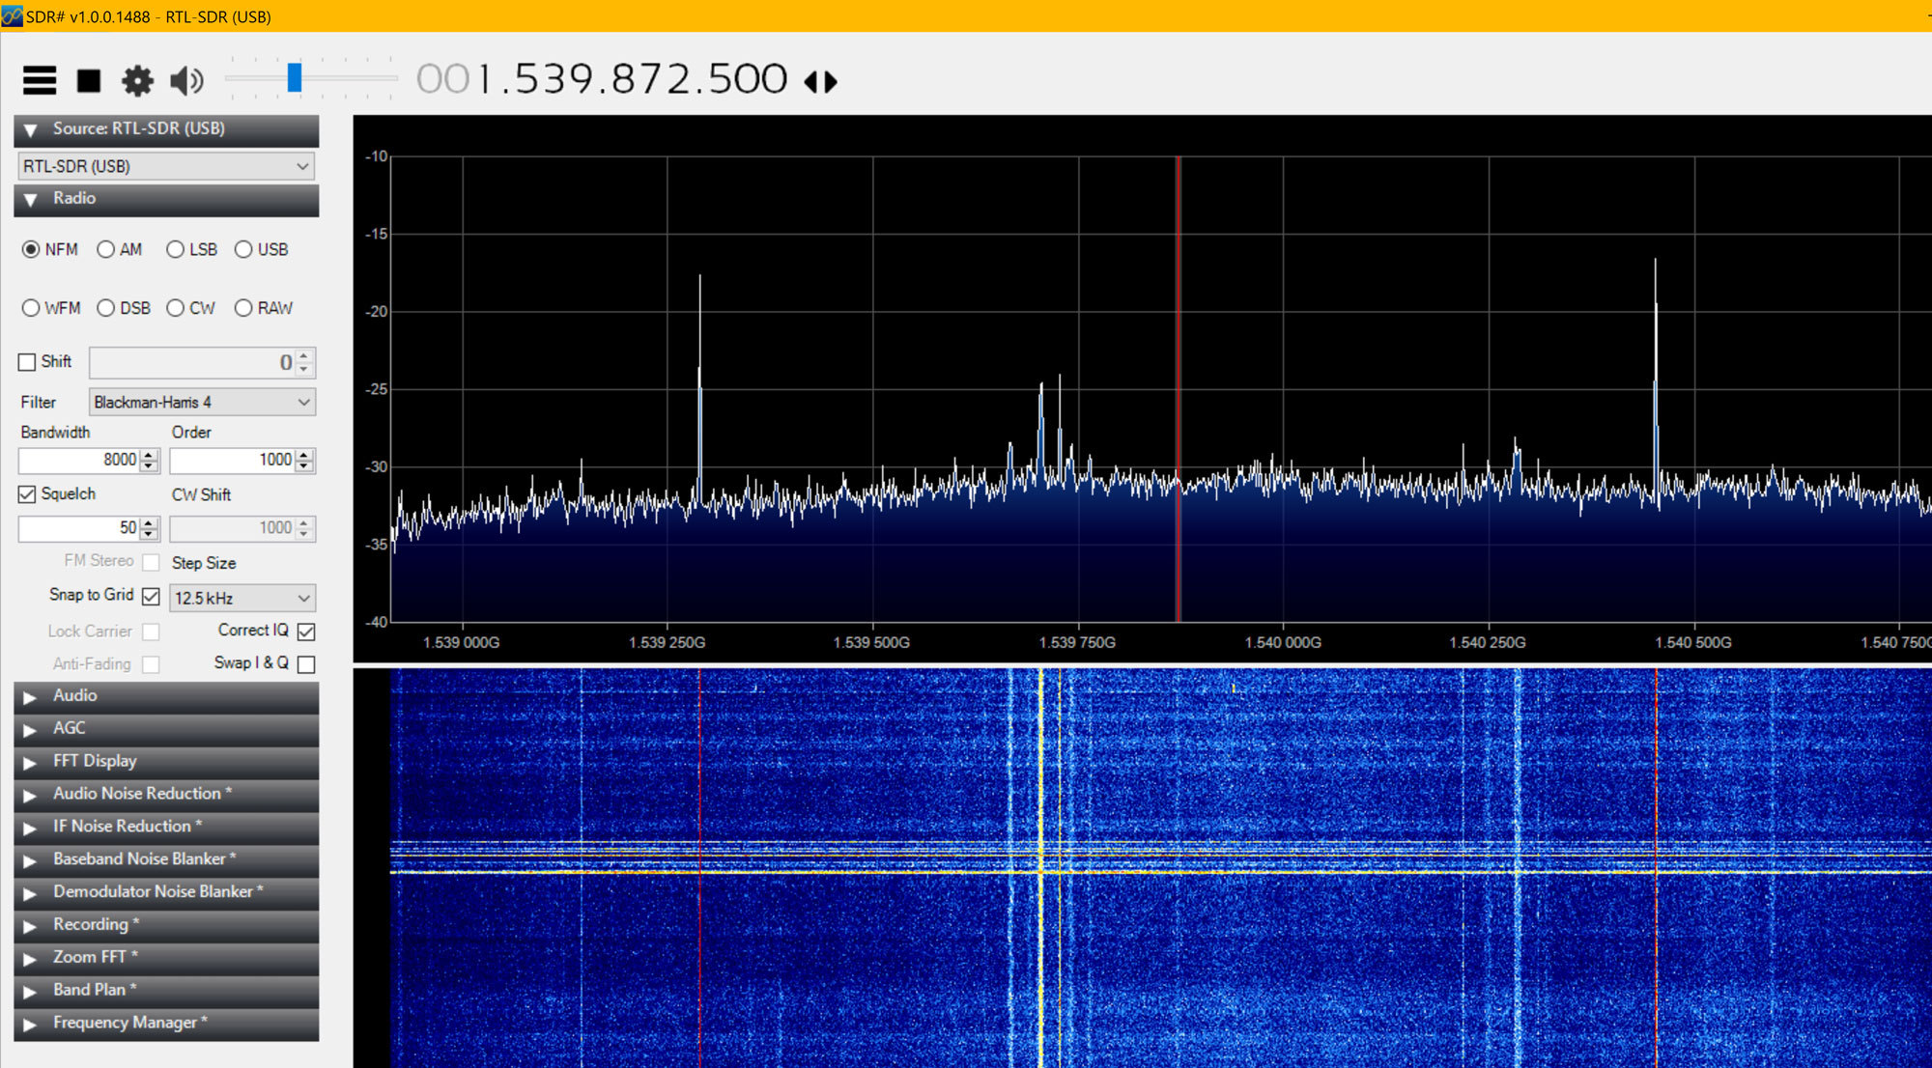
SDR Signal – Outernet North America

Slide 22
Raspberry Pi hardware
Purchased through Amazon, E-bay or other electronic parts suppliers.
Rasbeperry Pi 3 - $35.00
LNF filter - $20.69
RTL – SDR - $29.99
L-Band air Gap Patch Antenna – $29.99
4GB – 32GB SD card

Slide 23
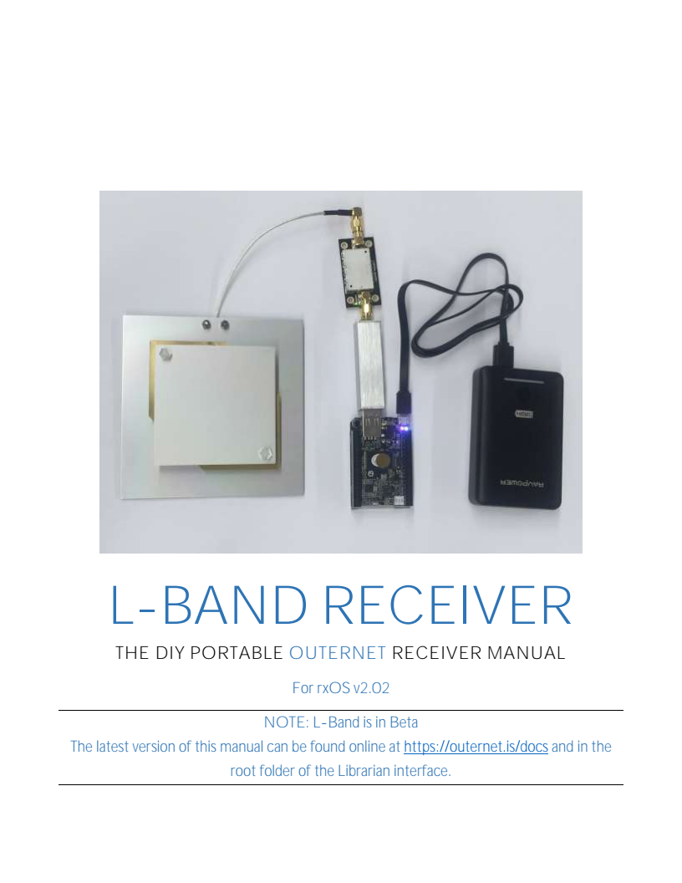
Raspberry Pi Hardware

Slide 24
Dreamcatcher Hardware
Purchase direct from Outernet
Dreamcatcher board ( This board takes the place of the raspberry pi 3, LNA filter, and SDR dongle. $39.00 + shipping.

Slide 25
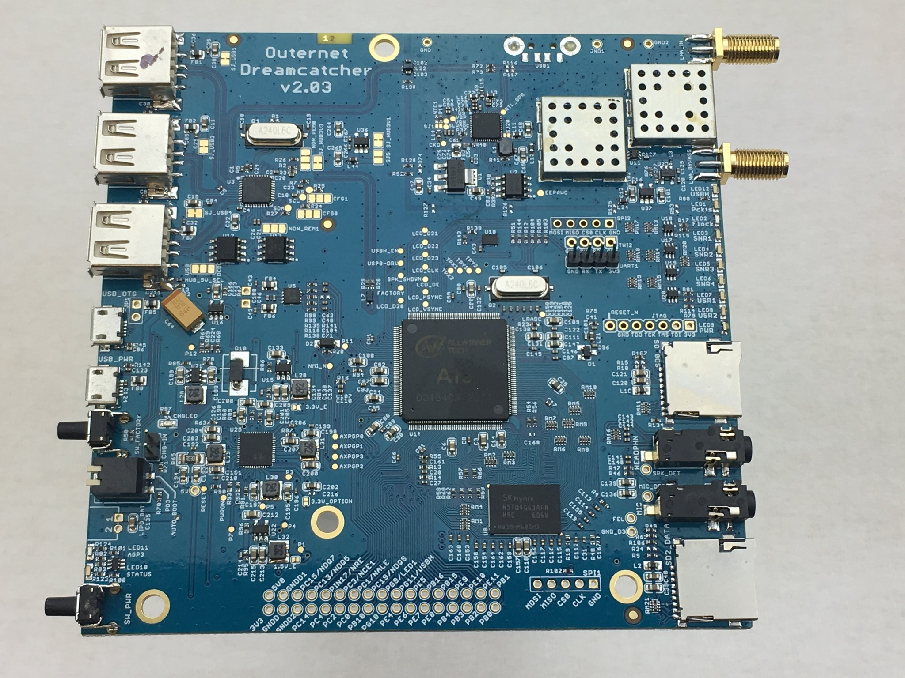
Dreamcatcher Hardware

Slide 26
It all starts here at Outernet.is

Slide 27
Case and L-band antenna holder 3D Printed
If you own a 3D printer and would like a copy of the .STL files please let me know.
Printed on the Creality CR-10 / CAD designed in Spark Mechanical Design / Sliced in Cura 3.0

Slide 28
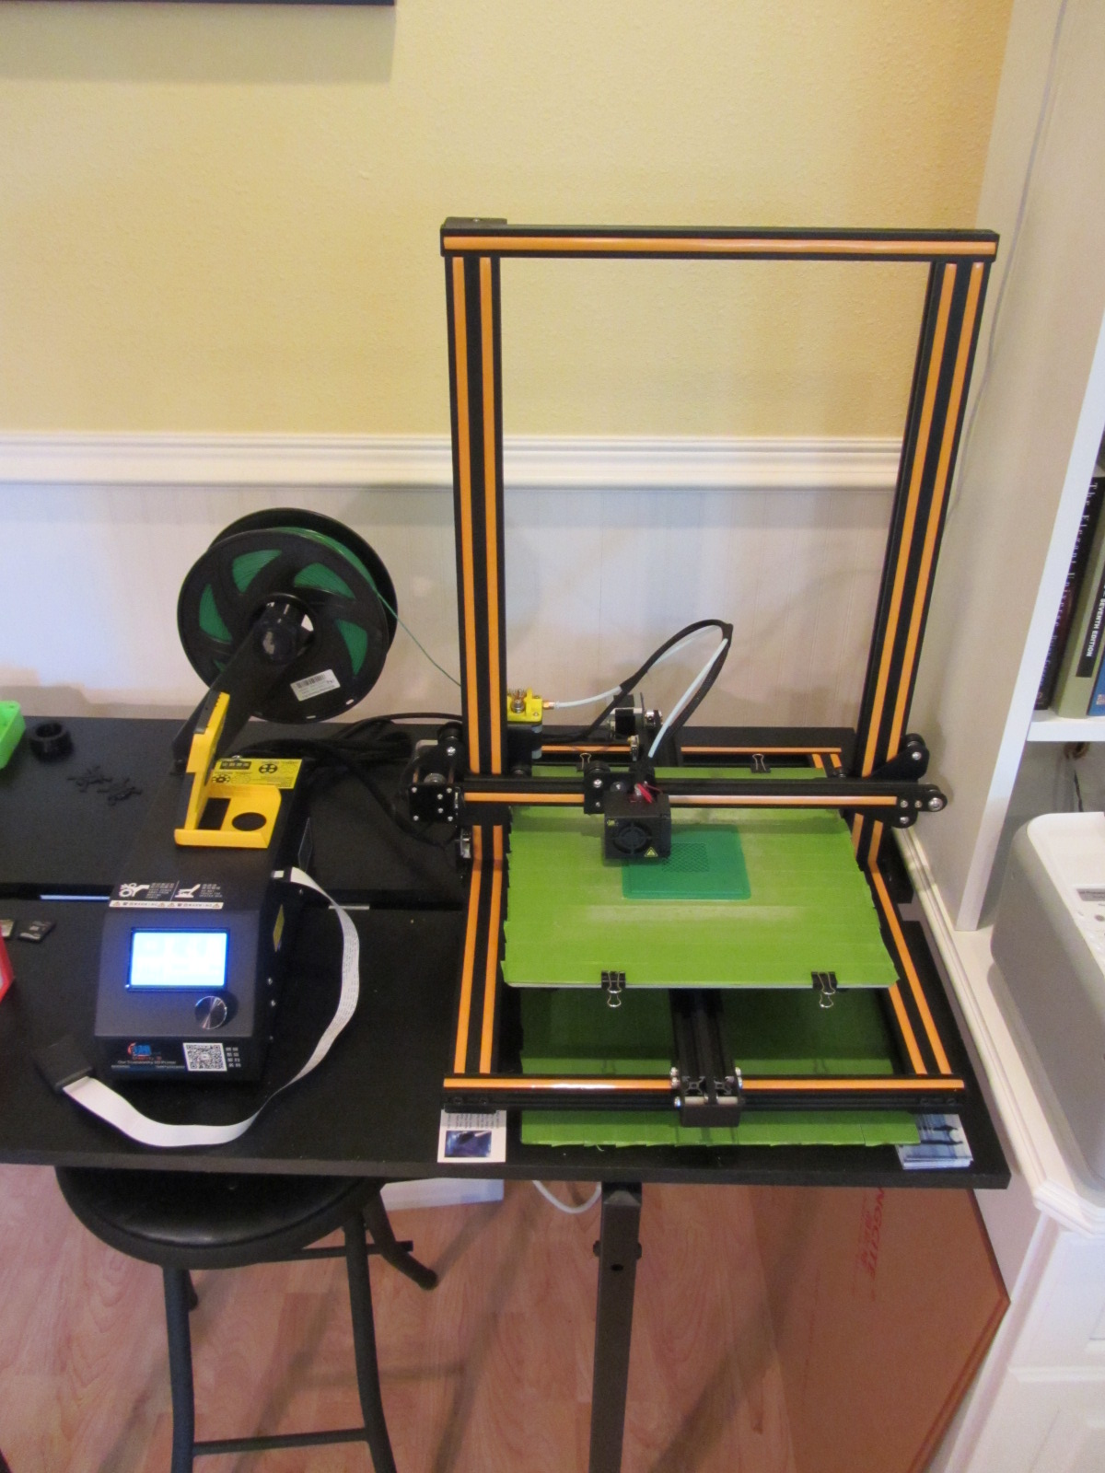
Creality CR-10
3D Printer
Case in 1.75mm PLA

Slide 29
Questions?
For further information or assistance please contact Bob Doherty at
KM4BAO@yahoo.com
Thank you!

