Slide 1
Crystal Sets
Al Sheppard
W4ZSC
W4ZSC@ARRL.Net

Slide 2
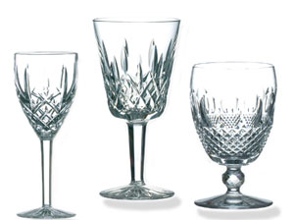
Waterford Crystal Set ~1990

Slide 3
Rough Evolution Of Radio Receivers
Coherer: 1900-1910 Spark detector based on RF agitating particles such as Ag & Ni—only dots and dashes from spark xmtrs.
Electrolytic: 1902-1913 First to detect AM. Low sensitivity, quickly replaced by diodes. Fine Pt wire touches acid electrolytic solution and rectifies.
Crystal: 1906-1930 Minerals rectify and could detect modulation. First for public reception of commercial radio
Regenerative: 1915-1940 economical from tube cost—difficult to tune and noise a problem
TRF: 1916-1940—lots of tuned circuits with little selectivity but could use speaker and great improvement on crystal.
Superhet: Patented 1918—practical from late 20’s and remains today. Delay due to L.O. and IF development along with expense of many tubes and power supplies.
Software Defined Radio—conceived in 70’s& 80’s. For hams has been a development of 90’s to present. Still evolving, but likely is the future.

Slide 4
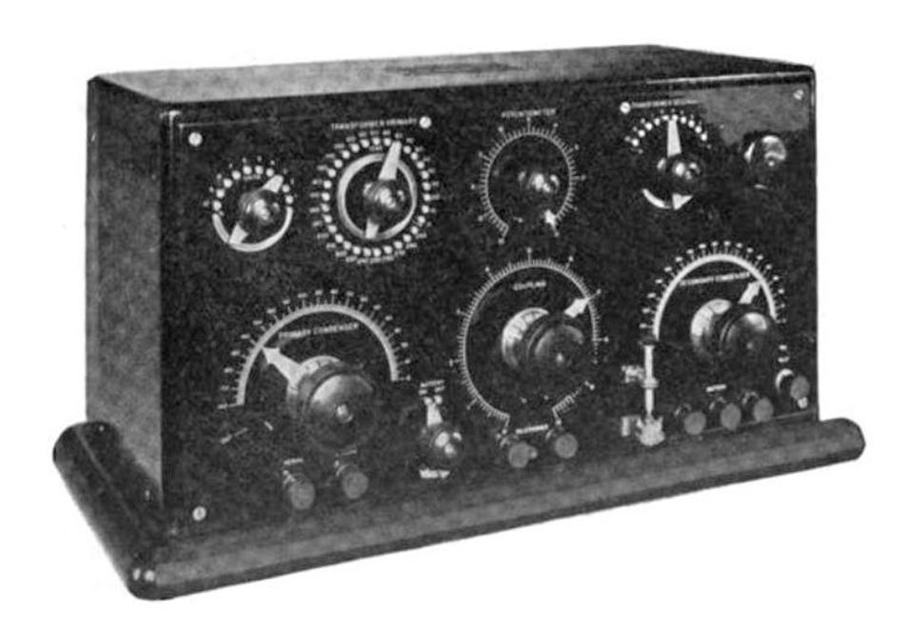
Marconi Crystal Set 1921

Slide 5
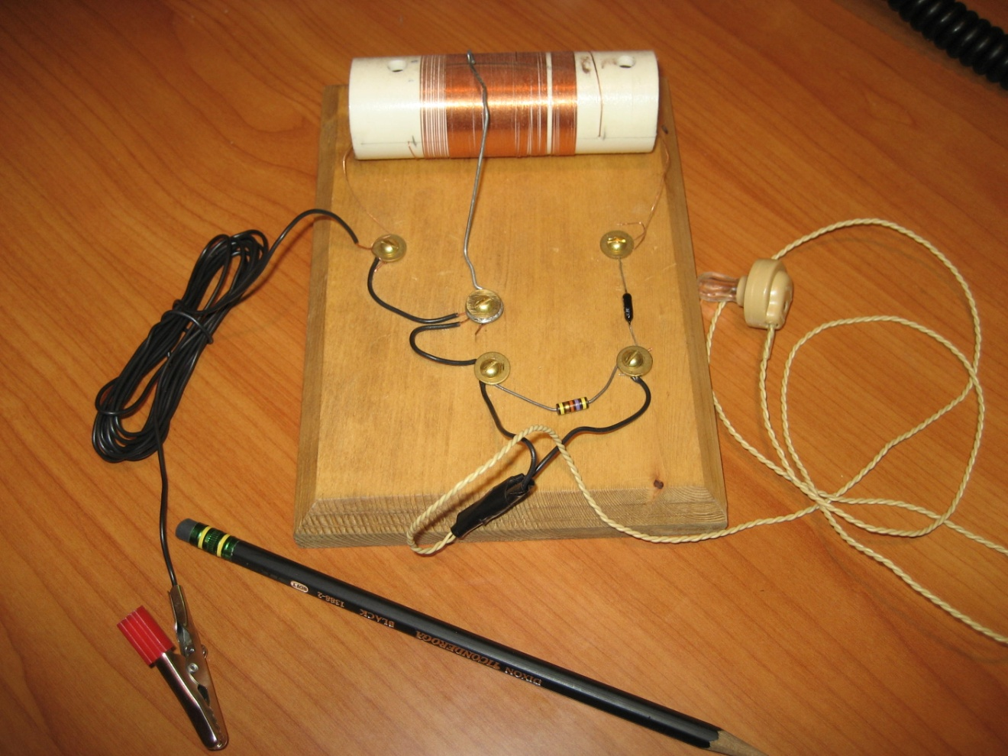
Cub Scout Crystal Radio
Parts: Wire for coil, PVC tube, resistor, germanium diode, headphones,, Fahnestock clips, paper clip for coil slider. No Variable Cap– use ~600uH

Slide 6
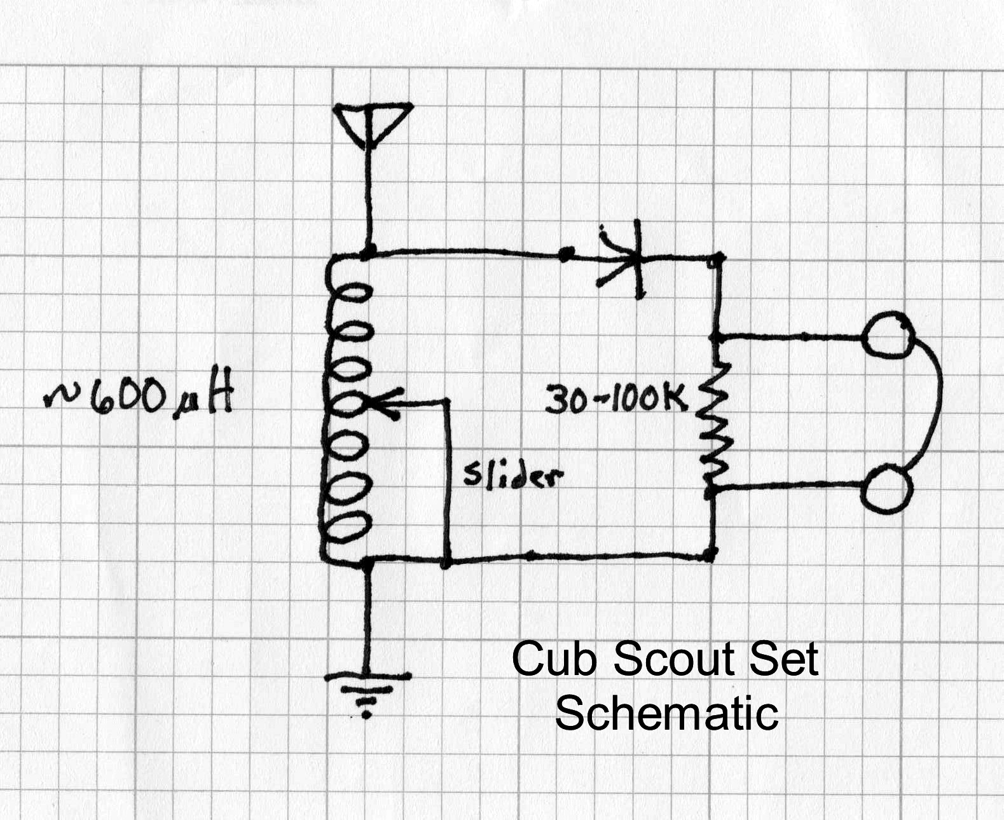

Slide 7
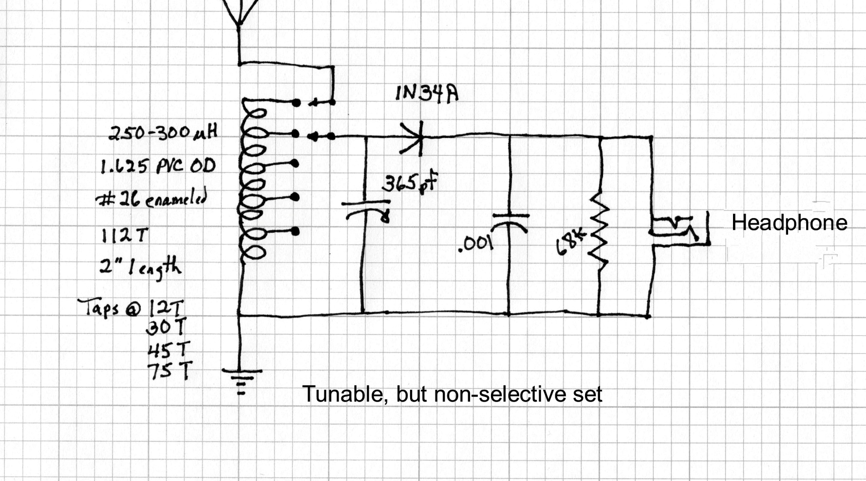
One Step Up From Cub Scout Set

Slide 8
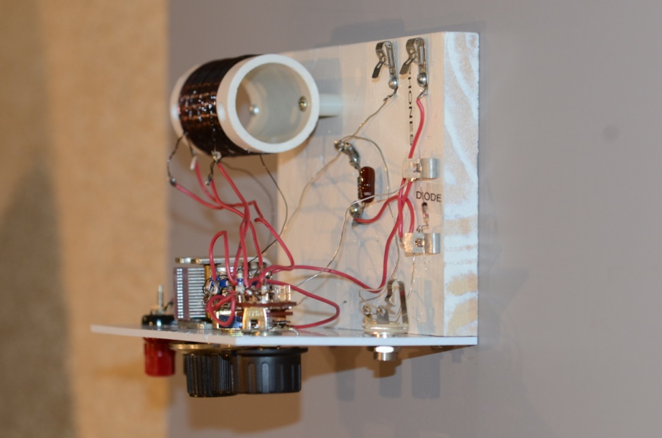
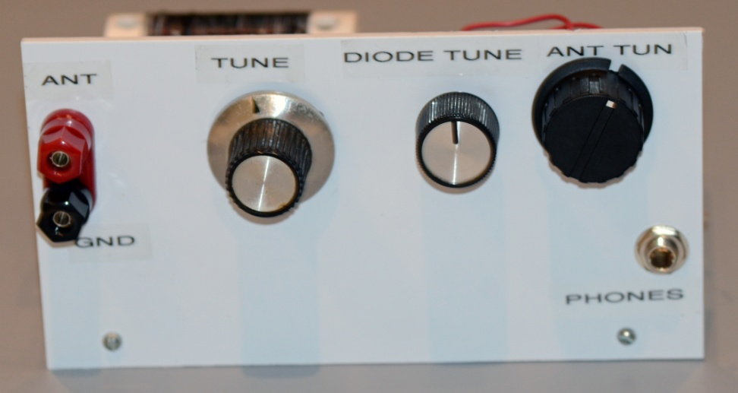
Tunable Demo Set
Front
Side Showing Switches Alligator Clips would do same job

Slide 9
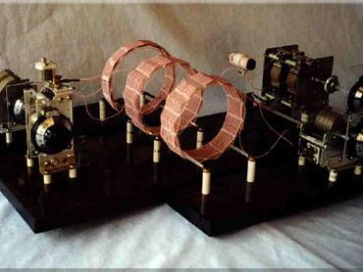
Tuggle Lyondyne Crystal Radio
Most sophisticated DX Crystal Set with traps to tune out near-by powerful stations

Slide 10
Birmingham, AL Crystal Set DX Contest BCB 2010
Name Stations Points Location
Mike Tuggle 106 845,105 Kaneohe, HI
Evan Haydon 393 791,938 Lincoln, NE
Ralf Siemieniec 227 393,417 Villach, Austria
O. T. Anderson 133 239,639 Broken Arrow, OK
Jack Bryant 85 106,689 Trussville, AL
Garry Nichols 92 96,881 Manlius, NY
Jerry Walker 44 60,750 Hammonton, NJ

Slide 11
Ingredients for Great Crystal Set
Good Antenna
High Q Litz Wire Coils
Low Loss Variable Capacitors
Traps for Local Stations also High Q
Sound Powered Headphones
High Performance Diodes
Patience, Location and Luck

Slide 12
Examples of Detector Materials
Germanium Diode -- 1N34, 1N60, 1N277 Cost ~ $0.25
Schottky Diode –1N5711, 1N5819, HP5082-2835 Cost ~$0.25 -8.00
Galena --lead sulfide
Iron Pyrites
Many other minerals in the sulfide, arsenide families
Gillette Razor Blade with pencil lead
Irish potato with two copper wires—unlike most radio projects it is edible if it doesn’t work

Slide 13
Diode Choices
Galena or Pyrite with Catwhisker—main reason to do is historical
Silicon—high voltage drop 0.5V seldom used
Germanium—lowest voltage drop 0.1-0.2V, but relatively low impedance
Schottky—voltage drop 0.25V, higher impedance. Used more often in sophisticated DX sets

Slide 14
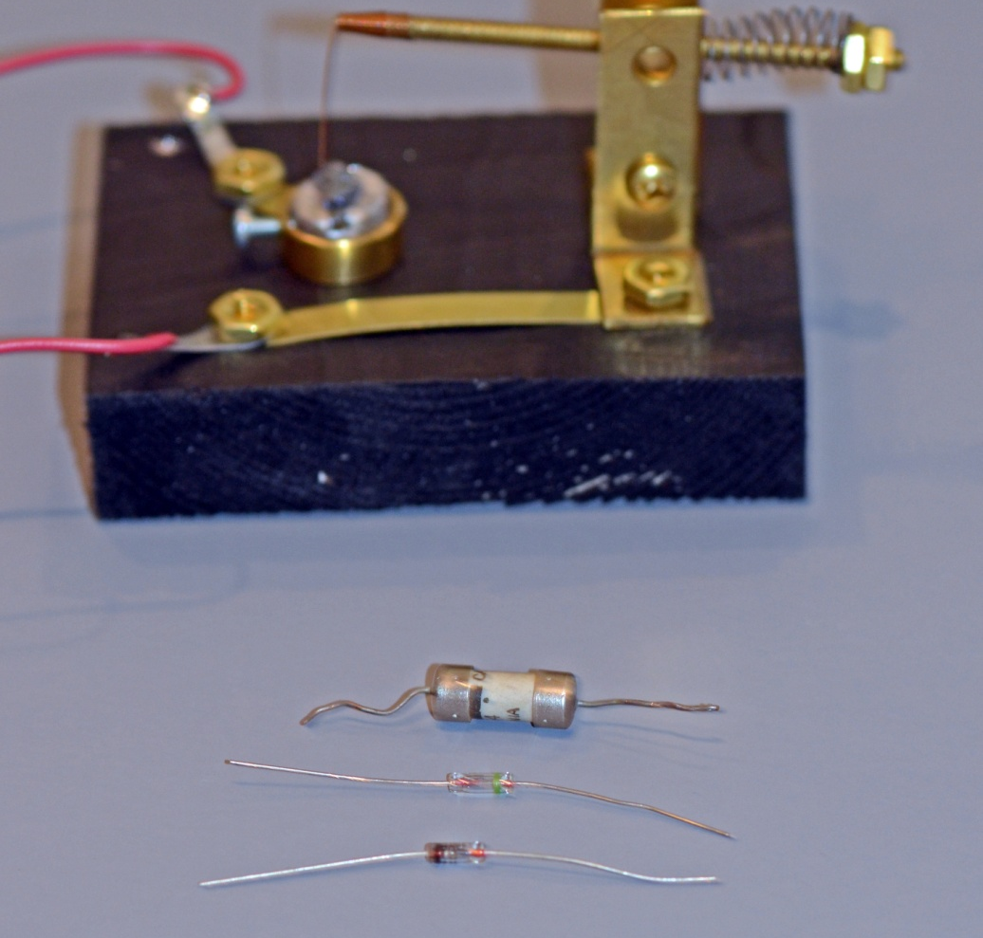
Evolution Of Crystal Diodes
Galena Cat whisker Detector. Original 1N34 ~1950. Current 1N34. Schottky Diode

Slide 15
Coils
Quickest is cheap ferrite BCB loop
Typical hobby sets use cardboard or PVC tubes
For BCB with 365 pF one normally would need about 262 uH to cover 500kHz
Professor Coyle does cylindrical calcs for you.
http://www.crystalradio.net/professorcoyle/professorcoylecyl.shtml
Other forms include spider web and basket weave

Slide 16
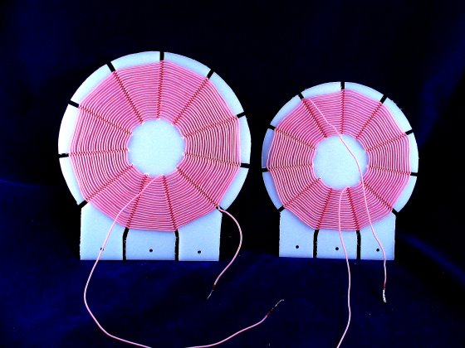
Spider Web Crystal Set Coils
Good High Q (though not as good as basket weave) See web site before attempting http://makearadio.com/coils/spider.php

Slide 17
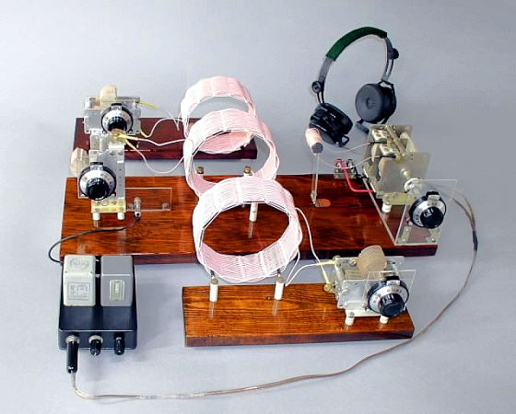
Mike Tuggle Basket Weave DX Crystal Set
Three Basket Weave Coils

Slide 18
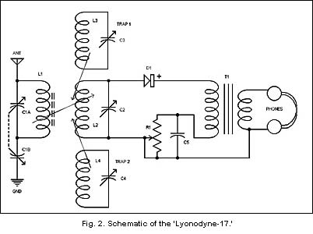
Tuggle Crystal Set Schematic
T1=100K-600 Ohm tapped secondary. Silver Plated, ceramic insulation variable capacitors 470 pf per gang, 2 gang in parallel. 660/46 Litz basket wound inductors ~185 uH, 4-5 in. dia.. L1 147 uH on 5/8 ferrite rod. C5 0.02 poly. Pot 500K linear.

Slide 19
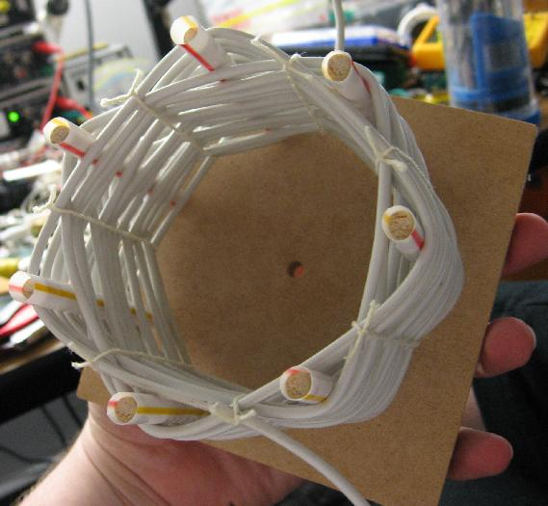
Close Up of Basket Weave Coil
Use Litz wire; 660/46 is ideal but costs about $0.80/foot. 0.056 Dia. Equiv to #18-22wire. Keep skin effect low.
Alternate between dowels. Five in. coil might use 13 dowels 0.125 in . Put acrylic rods/Duco or dental floss tape to keep windings in place.
Q’s of 700-1200 possible with Litz and great care

Slide 20
Headphones
Crystal—Piezoelectric, very high impedance must be used with resistor in parallel (30K-100K) Often used for simple receivers. Poor compared to magnetic or sound powered.
Magnetic—Magnetic coil current from radio causes vibration of magnetic diaphragm , usually about 2000 Ohms. Will work directly, but matching transformer helps.
Sound Powered—Armature vibrates from coil around it in midst of permanent magnet. Diaphragm is non-magnetic so can be lighter and move more easily. Ebay but expensive. Best for crystal radios. Typical impedance of a few hundred Ohms. Best to use transformer.

Slide 21
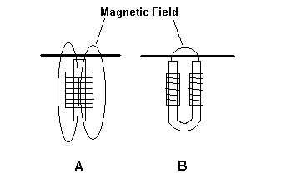
Design for Magnetic Headphones
From Darryl Boyd, All rights reserved

Slide 22
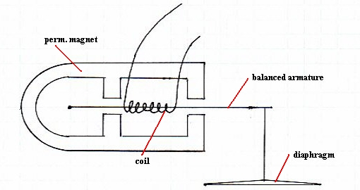
Sound Powered Headphone Design
From Darryl Boyd, All rights reserved

Slide 23
Antennas
Generally, the higher and longer the better
Low end of BCB is 566 M; half wave 928 ft.
Most try for height at least 30 ft. and at least 50 ft. length
One devoted Xtal Dxer sends up a helium balloon with 140 ft. Litz wire
Other than long wires, beverage and loaded high verticals are popular space permitting. Most BCB is vertically polarized
Some use large loops again if space permits
Advice: time to buy that mountain cabin on acreage you have always dreamed of

Slide 24
140 ft Vertical Antenna
Assume Number 24 stranded with 19 strands of #36 wire. Weight is 1.43 lbs/1000ft. 0.2 lbs for 140 ft.= 91 gm.
Assume a 10 gm. helium balloon 12 in. diameter. Use: www.heliumcalculator.com
Calculator says you would need 13 balloons.
If you could get a 24 in. balloon that weighed 20 gm., you would only need 1.

Slide 25
Useful Links
Crystal Radio Link http://www.crystalradio.net/
Yahoo Group Crystal Radio thecrystalsetradioclub@yahoogroups.com
Xtal Set Society www.midnightscience.com
Coil Winding http://www.crystalradio.net/professorcoyle/professorcoylecyl.shtml
Birmingham Crystal Radio Club http://www.crystalradio.us/index.htm
Crystal Set DX Site http://makearadio.com/misc-stuff/dxnotes.php
Ben Tongue Crystal Analysis http://www.bentongue.com/xtalset/xtalset.html
Scott’s Hard to Find Parts http://www.angelfire.com/electronic2/index1/index.html
European Crystal Site http://www.crystal-radio.eu/index.html
Modern Radio Labs, parts & many diagrams http://www.modernradiolabs.com/
Spider Web Coils http://makearadio.com/coils/spider.php
Boyd’s Sound powered phones http://www.crystalradio.net/soundpowered/
Antenna Designs http://www.dxzone.com/cgi-bin/dir/jump2.cgi?ID=11200
Tuggle Set Description http://www.antiquewireless.org/otb/dxxtal.htm

